Slide 1
Project
Car Price Prediction
Submitted by
Laxmi Narayan

Slide 2
Contents
Introduction
Data Preparation
Exploratory Data Analysis
Prediction and Modeling Techniques
Model Building and Evalution
Analysis and comparison
Conclusion

Slide 3
Introduction
Determining whether the listed price of a used car is a challenging task, due to the many factors that drive a used vehicle’s price on the market. The focus of this project is developing machine learning models that can accurately predict the price of a used car based on its features, in order to make informed purchases. We implement and evaluate various learning methods on a dataset consisting of the sale prices of different makes and models across cities in the United States. Our results show that Random Forest model and K-Means clustering with linear regression yield the best results, but are compute heavy. Conventional linear regression also yielded satisfactory results, with the advantage of a significantly lower training time in comparison to the aforementioned methods.

Slide 4
Conti..
Machine learning uses data science and makes it feasible to generate such models which are able to make accurate predictions,classisfy things into categories,interpretation of images,etc.This makes the machines and robots intelligent as they can learn on their own and there is no need to worry about their accuracyThe goal of this project is to create a regression model and a classification model that are able to accurately estimate the price of the house given the features.

Slide 5
Data Preparation
he dataset contains a large number of variables that are involved in determining a used Car price. We obtained a csv copy (Train and Test set)of the The data is collected from the Indian online shoppers.
Data Description:The dataset contains 6019 records (rows) and 15 features (columns).

Slide 6
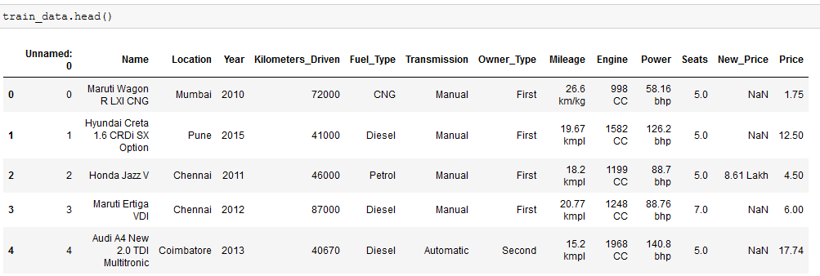
Conti..

Slide 7
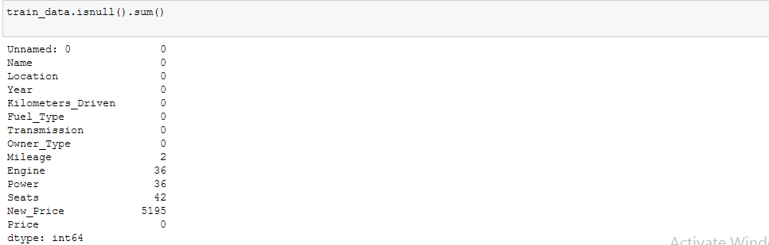
Data cleaning:Dealing with missing values

Slide 8
Feature Engineering
For hadeling categorical data. We modtly use these 2 path:
OneHotEncoder
LabelEncoder
Where OneHotEncoder is used where data are not in any order and LabelEncoder when data is in order.
So, for each Features we will use plots to find out what to be used there.
As for now we have left with only 5 categorical features:
Location
Fuel_Type
Transmission
Owner_Type
Company

Slide 9
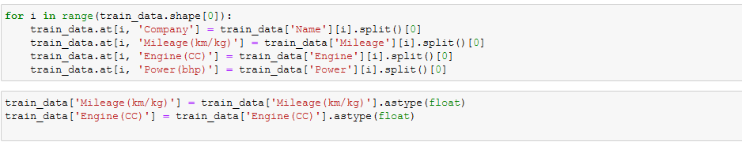
Conti..

Slide 10
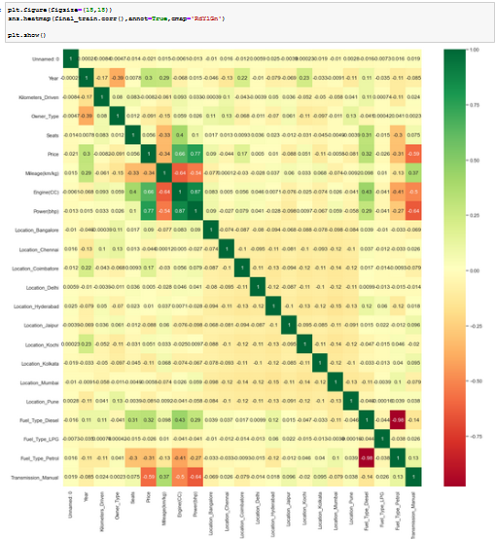
HeatMap

Slide 11
Conti..
Firstly, we want to visualize the relationships between the target variable and the variables that are highly and positively correlated with it, according to what .we saw in the heatmap.

Slide 12
Model Building
Dummies will be used for converting categorical variables into numerical variables because sklearn models allows only numerical inputs.
The train data set will be divided into two parts,80% of the data will act as training data and the remaining 20% data will be the validation data.

Slide 13
Model Selection
Let’s model each classification algorithm over the training dataset and evaluate their accuracy and standard deviation scores.
LogisticRegression
Random Forest

Slide 14
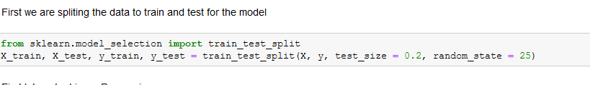
Train-Test Splitting

Slide 15
Modeling Approach
Choose an algorithm that implements the corresponding technique
Search for an effective parameter combination for the chosen algorithm
Create a model using the found parameters
Train (fit) the model on the training dataset
Test the model on the test dataset and get the results

Slide 16
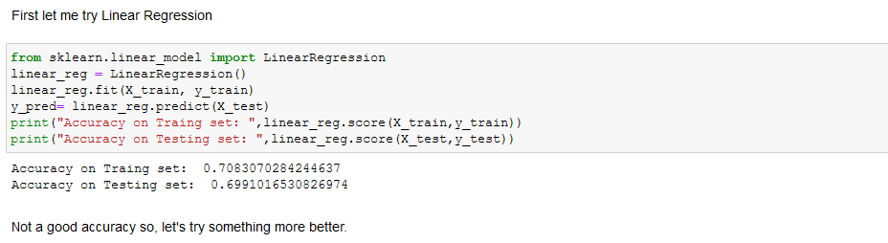
Logistic Regression

Slide 17
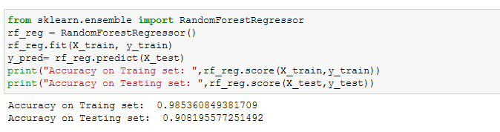
Random Forest Algorithm

Slide 18
Checking accuracy of the model
Evaluating the model accuracy is an essential part of the process of creating machine learning models to describe how well the model is performing in its predictions. The MSE, MAE, and RMSE metrics are mainly used to evaluate the prediction error rates and model performance in regression analysis.

Slide 19
Conti..
MAE (Mean absolute error) represents the difference between the original and predicted values extracted by averaged the absolute difference over the data set.
MSE (Mean Squared Error) represents the difference between the original and predicted values extracted by squared the average difference over the data set.
RMSE (Root Mean Squared Error) is the error rate by the square root of MSE.

Slide 20
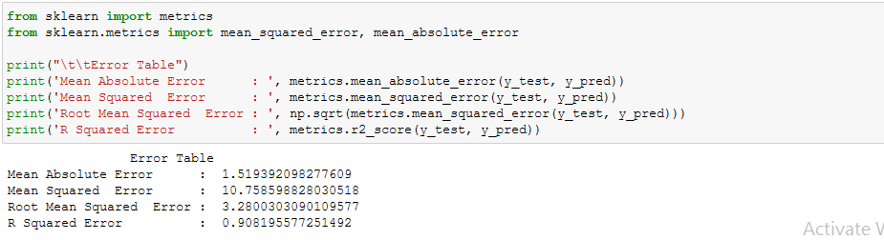
Conti..

Slide 21
Conti..
After the model evaluation , we get the accuracay for Train and Test data are 0.98and 0.92.
Model evaluation gives the results that the prediction is very accurate

Slide 22
Conclusion and Future Work
For better performance, we plan to judiciously design deep learning network structures, use adaptive learning rates and train on clusters of data rather than the whole dataset. To correct for overfitting in Random Forest, different selections of features and number of trees will be tested to check for change in performance.

